Slide 1


RETAIL POINT SALE SYSTEM
K.RAMAKRISHNAN COLLEGE OF TECHNOLOGY
(AUTONOMOUS), TRICHY.
NIRANJAN KUMAR M
2303811710421107
GUIDED BY
Mrs S.KEERTHANA/CSE/ TEACHING ASSISTANT

Slide 2
ABSTRACT
This Retail point sale System uses Flask (backend), MySQL (database), and Tkinter (frontend) to manage products, track stock, and record sales. The backend provides APIs for product and sales management, while the frontend allows users to add products, process sales, and view transaction history. Ideal for small retail businesses.

Slide 3
INTRODUCTION ABOUT PROJECTS
Project Objective
The Retail POS System helps small businesses manage products, track inventory, and record sales efficiently.
Scope & Features
It allows adding products, updating stock, processing sales, and viewing sales history with real-time updates.
Impact & Benefits
The system reduces errors, speeds up transactions, prevents stock shortages, and improves business efficiency.
Methodology & Approach
It uses Flask for the backend, MySQL for data storage, and Tkinter for a simple user interface.
Future Enhancements
Future upgrades include user authentication, sales reports, barcode scanning, and cloud storage for remote access.

Slide 4
PROPOSED ARCHITECTURE
View Stock
USER INTERFACE
Add and update Products
Process Sales
Handles API calls
Backend
Manages
Stock
Stores Products and sales
Database (MySQL)
Updates Stock

Slide 5
PROPOSED EXPLANATION ADVANTAGES
User-Friendly Interface – Simple Tkinter GUI for easy product and sales management.
Efficient Data Handling – MySQL database securely stores and updates product and sales records.
Fast & Automated Transactions – Flask backend processes sales instantly, reducing manual work.
Stock Management – Automatically updates stock after each sale to prevent shortages.

Slide 6
MODULES OF THE PROJECTS
Product Management Module
Sales Management Module
Database Management
Backend API Module
User Interface Module

Slide 7
EXPLANATION OF MODULES
Product Management Module
Add, update, and retrieve product details (name, price, stock).
Ensures inventory is maintained properly.
Sales Management Module
Processes product sales and updates stock accordingly.
Calculates total price and records sales transactions.
Database Management Module
Stores product and sales data using MySQL.
Ensures data integrity and retrieval for reports.
Backend API Module
Built with Flask, handling API requests.
Manages communication between the frontend and the database.
User Interface Module
Developed using Tkinter to provide a graphical interface.
Displays products, allows sales processing, and shows sales history.

Slide 8
LANGUAGE USED
Front-End
Tkinter (Python GUI Library)
Used for designing the user interface of the POS system (product display, input forms, buttons).
Back-End
Flask (Python Web Framework)
Handles API endpoints for product and sales data (GET and POST requests).
Database
MySQL
Stores all data related to products, stock, and sales.

Slide 9
PROBLEMS TO SOLVE
Add and manage products
Track sales and stock in real time
View sales history instantly
Reduce manual workload and errors

Slide 10
SOFWARE ANALYSIS
Python 3.x – Core language used for GUI, API, and database interaction
MySQL Server – For running and managing the MySQL database
pip (Python Package Installer) – For installing necessary libraries like mysql-connector-python, flask

Slide 11
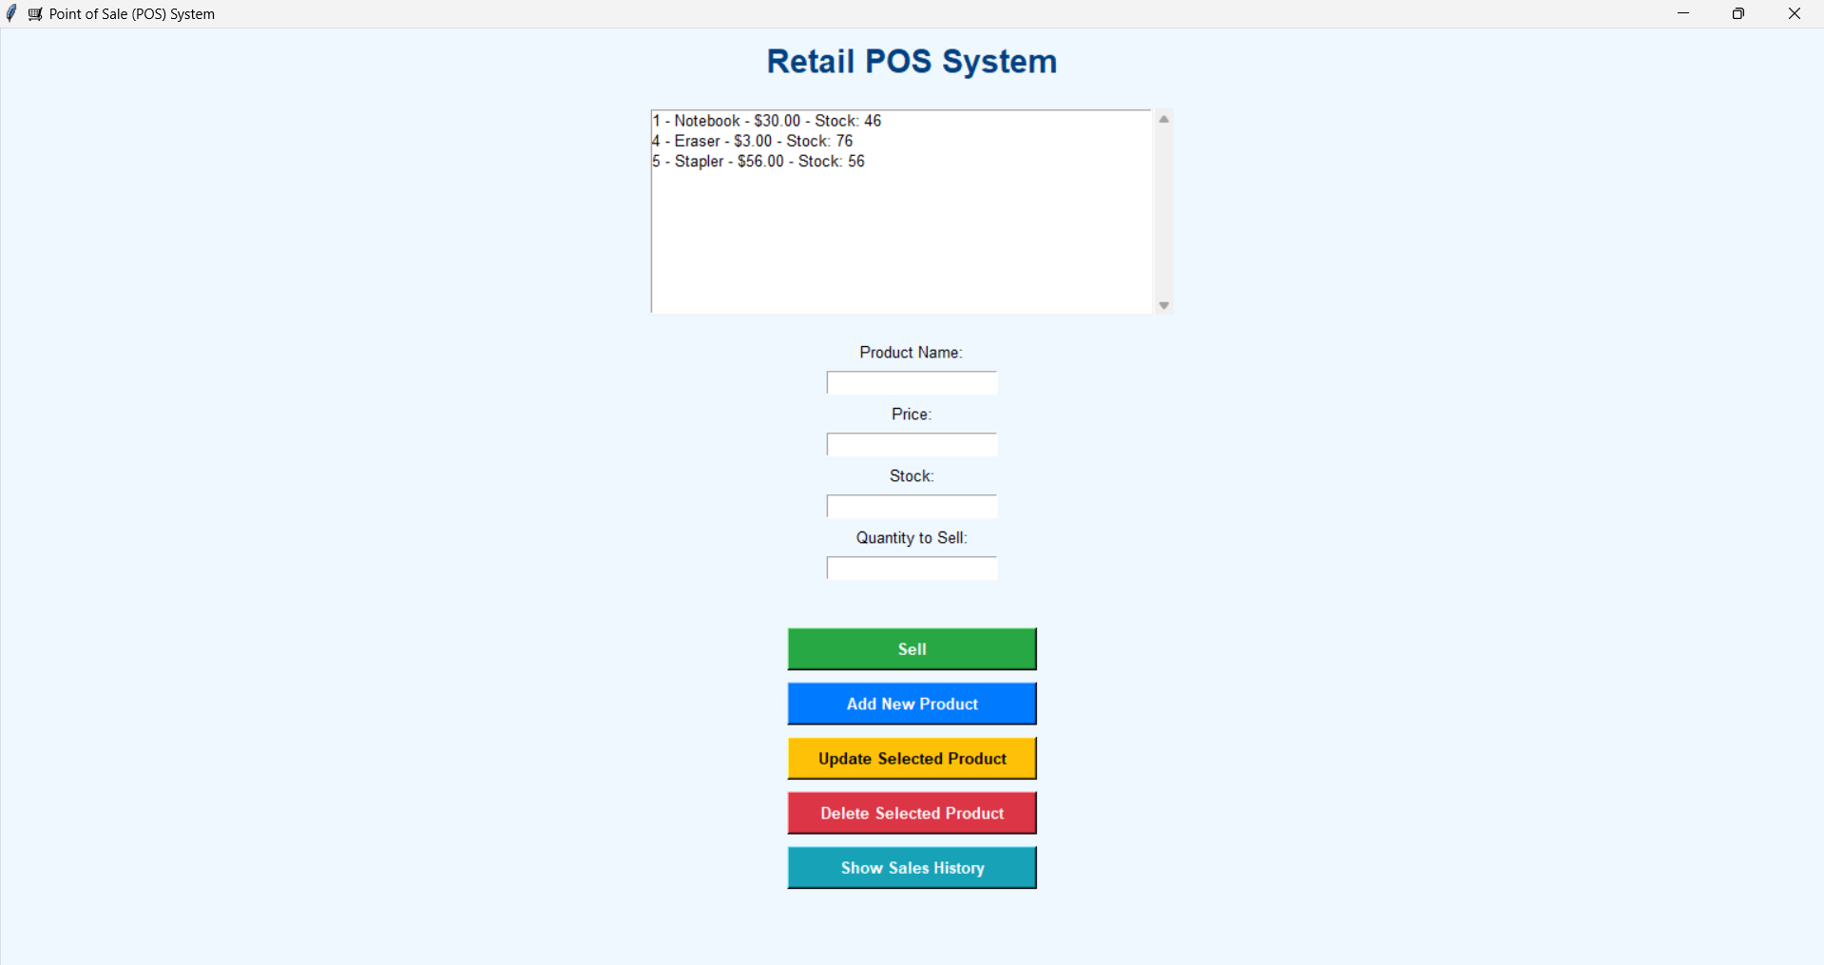
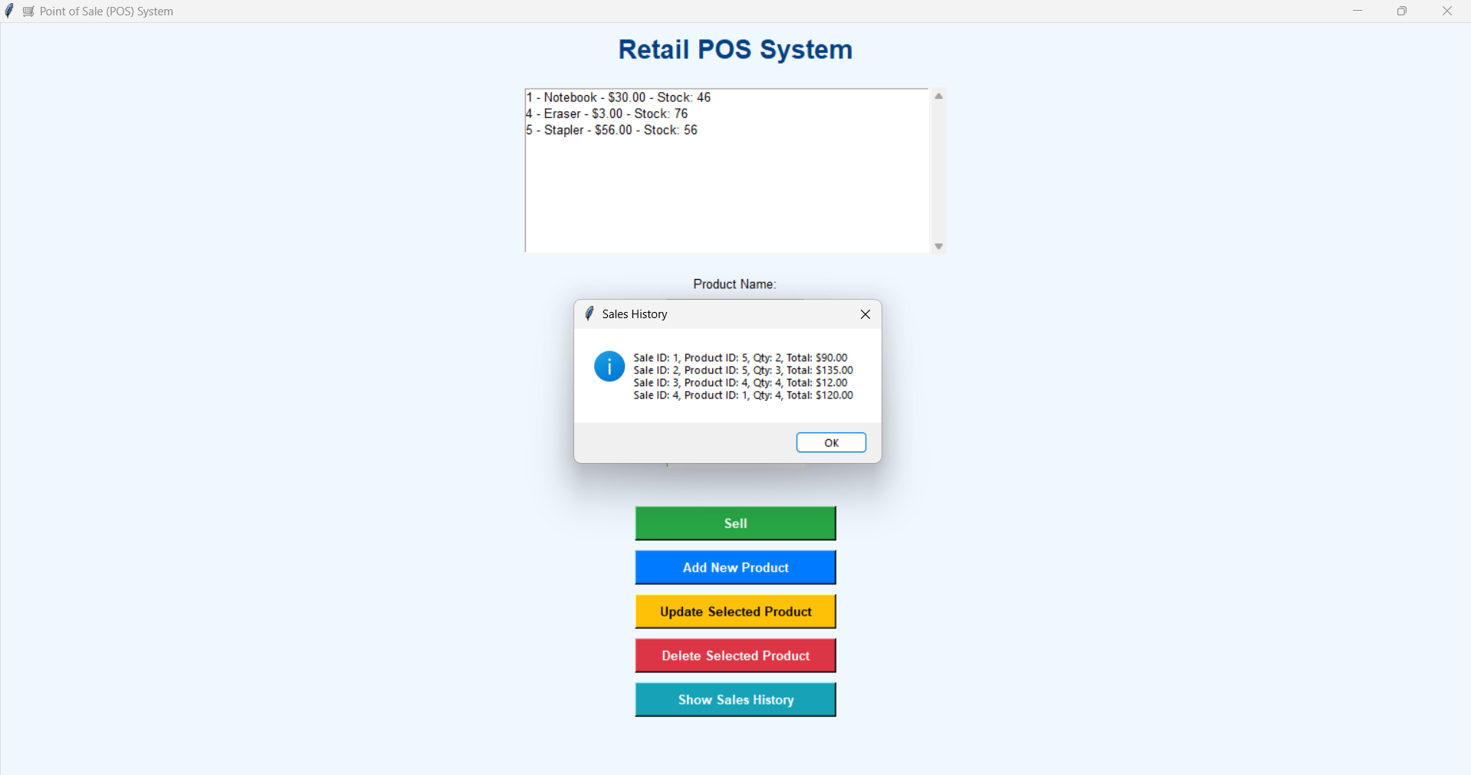
OUTPUT

Slide 12
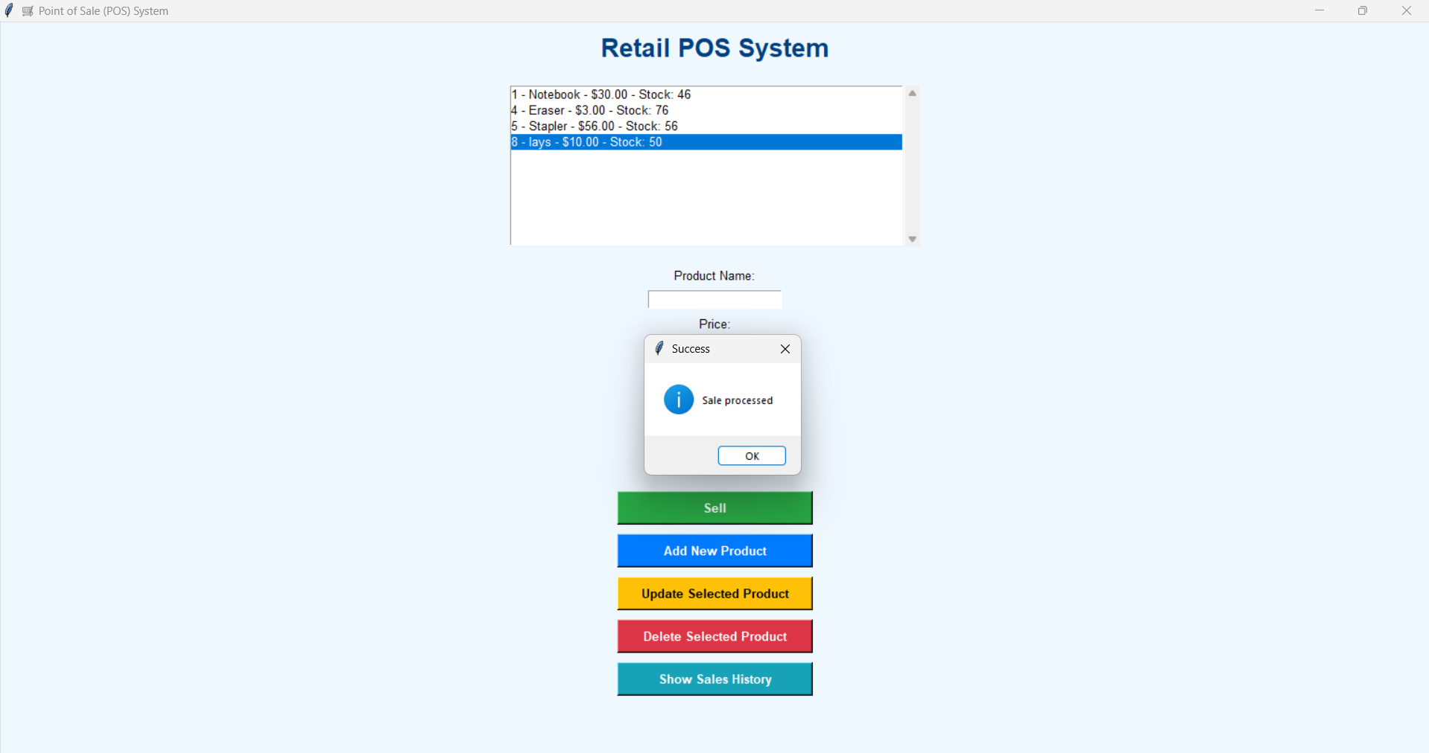
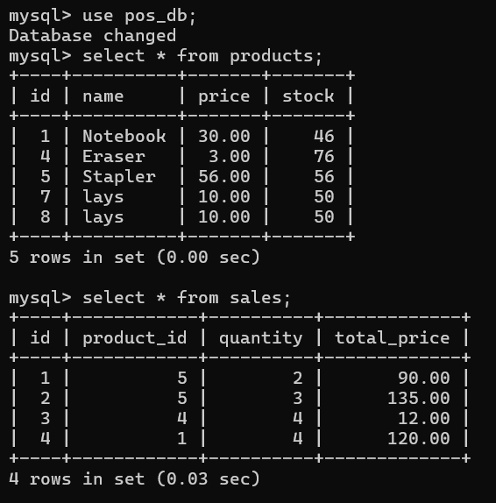

Slide 13
CONCLUSION
The POS system simplifies sales and inventory management by integrating a user-friendly GUI with a powerful backend and database. It improves accuracy, saves time, and provides a seamless way to track products and sales.

Slide 14
THANK YOU !!!!

